Slide 1
Taxonomic Matching Between Two Systems with NLP
Final Data Science Capstone
-Colette Gabriel

Slide 2

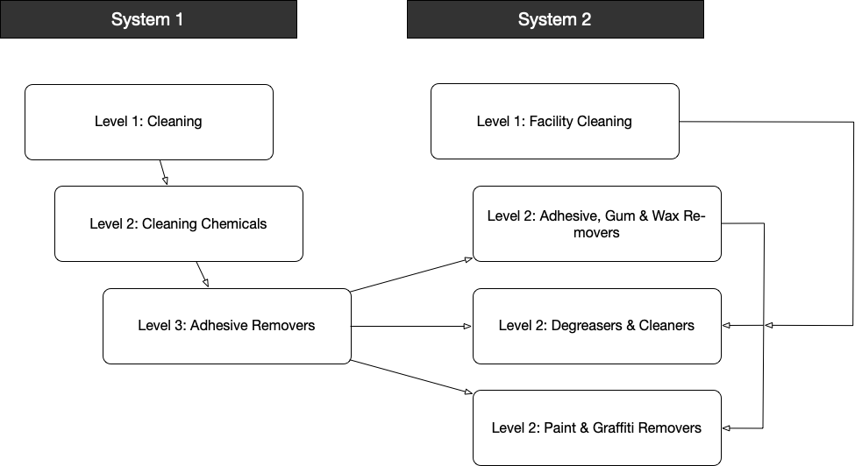
Problem Definition
Need to combine product metadata from two different companies that have merged
Different taxonomic node structure
Different attributes
Ex. System 1: Adhesive Removers has 20 attributes, System 2: Degreasers & Cleansers has 39 unique attributes
Data pipeline between the two systems did not exist
Ultimate goal is to move both datasets into one combined new software environment

Slide 3
Problem Definition, cont.
Text categorization – Given an unknown attribute in System 1, can we map it to the similar concept in System 2?
About 20% of the data is “labeled” and can be used for supervised learning
Attributes where attribute names match exactly in the two systems
Nodes where the taxonomy has done the mapping manually (10 categories)

Slide 4
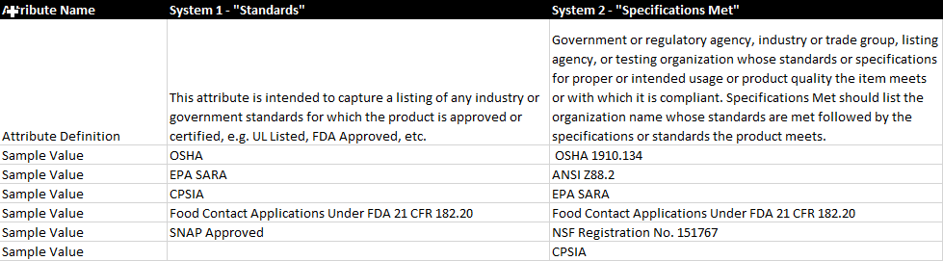
Problem Definition, cont.
Features used were existing attribute names, attribute definitions, and attribute values in each node

Slide 5
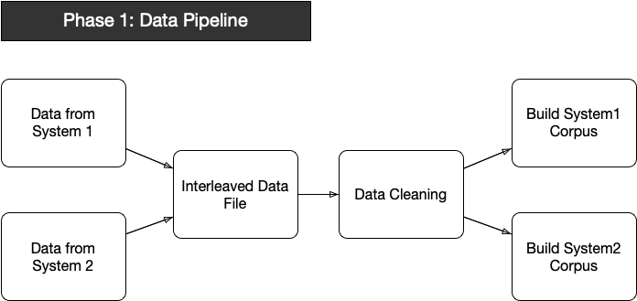
Getting the Data
Build pipeline to extract data from separate platforms:
System1 from Teradata
System2 from Postgres
Combine data into single taxonomy file based on where similar products are stored in each system
Clean data
Determine relevant features for each corpus

Slide 6
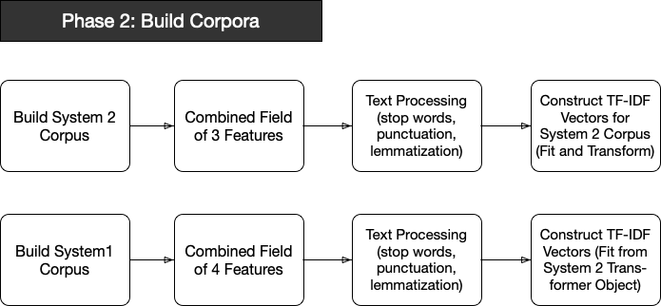
Building the Corpora
Parallel paths but handled separately because of differing features in the two systems
Text preprocessing using Spacy
System 2 chosen as basis for TF-IDF index because it contains greater number of attributes per node
System 1 matrix fit to TF-IDF transform object from System 2

Slide 7
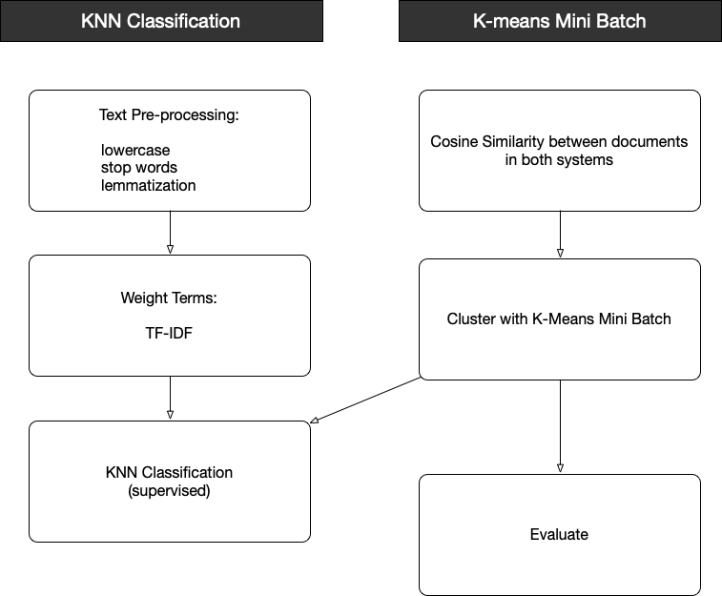
Text Categorization

Slide 8
Text Categorization
Pre-processing
Created new feature that combined
Attribute name
Attribute definitions (System 1 has two definition fields, System 2 has one)
All attribute values
Tokenized this new field and removed stop words and punctuation
Lemmatization – reduce word to its word root

Slide 9
Text Categorization, cont.
Weight Terms:
Term Frequency
Search for the highest value words in each document based on how often they occur
Inverse Document Frequency
Term weights in the document are measured against how often the term appears in the entire corpus
Ex. “Attribute” wouldn’t be very important to categorization because it appears in nearly all of the attribute definitions

Slide 10
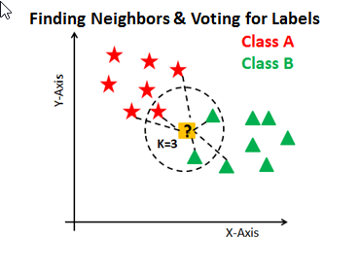
K-Nearest Neighbors
Supervised learning algorithm that can be used with the documents that are already classified
“Lazy” Algorithm – does not need training in advance
Model structure is determined from the dataset
Con is that the testing phase is slowed down
Works well here because number of features is typically 15-20

Slide 11
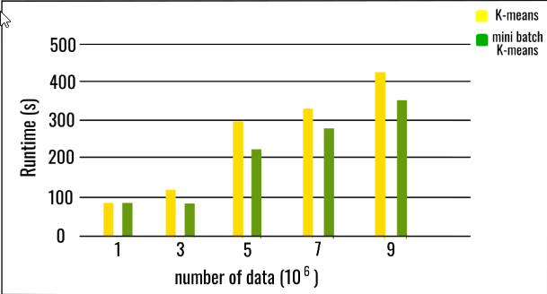
Mini Batch K-Means
K-Means is a popular clustering algorithm because it works quickly
Disadvantage is that the entire dataset has to remain in memory
Not feasible with the size of the two datasets
Mini Batch K-Means uses small, fixed-size random batches of the data (more easily stored in memory)
Each mini batch updates the clusters and learning rate decreases as iterations continue

Slide 12
Mini Batch K-Means, cont.
Each category can be clustered using the K-means algorithm
Number of clusters is the number of attributes to be mapped to in System 1 (based on TF-IDF matrix generated for System 2), or maximum number of attributes when the number is smaller
Randomly generate centroid
Assign each doc to the closest centroid and update based on average value (using cosine similarity) of the existing cluster data
Iterate until centroid data converges

Slide 13
Results
Only processed so far on small test batches, but results look promising
Using confusion matrix, we get total accuracy of about 92.3%
Class accuracy (system 1) around 91%
Class accuracy (system 2) around 93.4%

